Slide 1
Example Knowledge Exchange activities
People based activities
For example
Participating in Networks
Sitting on Advisory Boards, Steering Groups
Standard setting forums
Delivering Training
Curriculum Development
Enterprise education
Student placements
Attending Conferences, events, workshops
Community based activities
For example:
Public Exhibitions and events
School projects
Lectures and seminars for communities
Community based sports
Problem Solving Activities
For example
Joint research
Hosting personnel
External Secondments
Prototyping and testing
Consultancy services
Contract research
Physical facilities
Informal advice
Research consortia
Commercialisation Activities
For example
Joint research
Patenting
Spun out company
Formed/run consultancy
Adapted from UKIRC (2010) Knowledge Exchange between Academics and the Business, Public and Third Sectors
Notes:
Change for original picture

Slide 2
Simple model
How…Pathways to Impact
Research uptake: people are reading the outputs, talking about the findings etc. (media coverage, conferences)
Research use: users are applying it to policy or practice, views are changed
Research impact: contribution to long term sustainable change as a result of research use
Research Contribution Analysis, adapted from Sarah Morton (2012)
However experience shows that a body of work results in impact, not necessarily one stand alone study

Slide 3
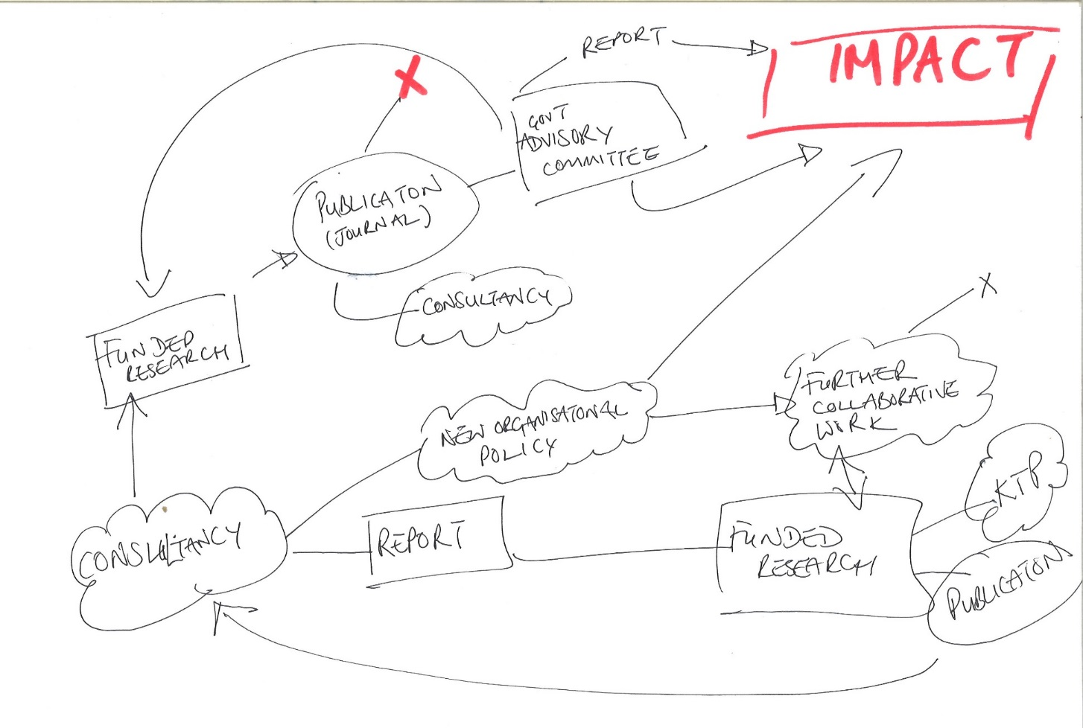
In reality….
How……Pathways to impact
“Ideas that can improve the standard of living and the quality of life often emerge through a process involving some combination of chance, serendipity and unintended consequences – and often with a long time lag between the idea and the impact.”
Hughes, A; Kiston, M; (2012)

Slide 4
Top tips to what works…
Awareness of the business or practice context of users
Users involved from outset and throughout (Co-production)
Early and well-planned user engagement and KE
Accessible findings and role of intermediaries and brokers
Establishing and maintaining networks and relationships
Good management and infrastructure support
Adapted from ESRC research

